Slide 1
Research on Geometrical Modeling and Physical Properties of Porous Structure of Human Bone
Tiansu Wang
High School Affiliated to Shanghai Jiaotong University
China

Slide 2
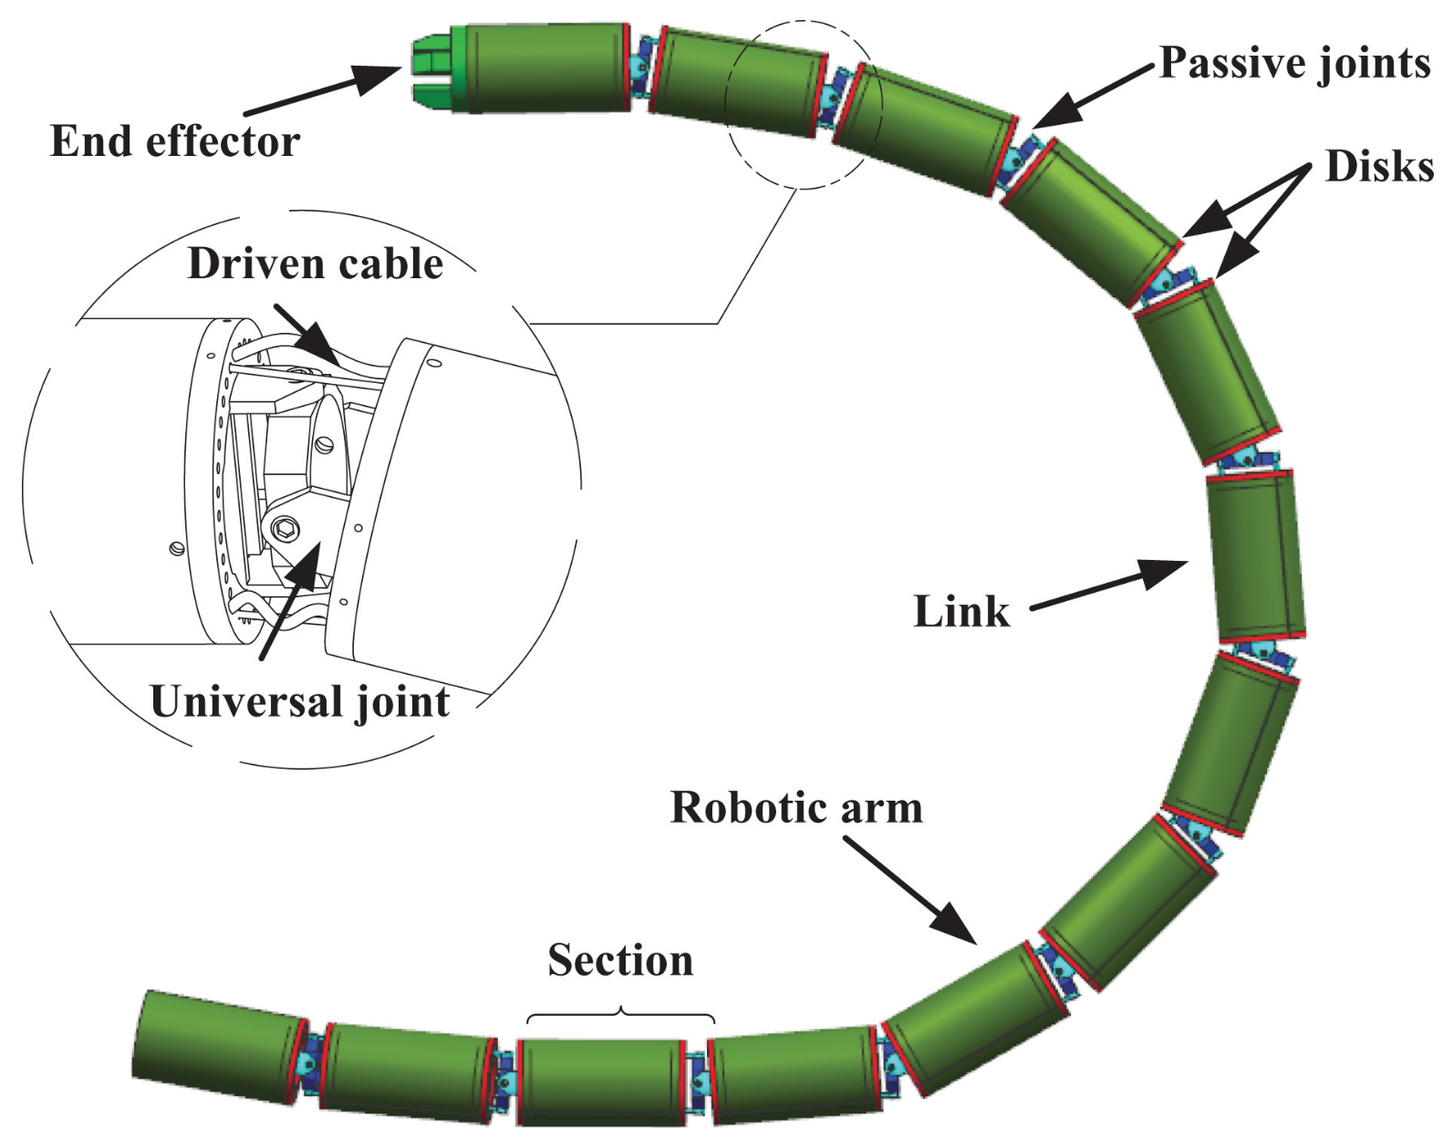
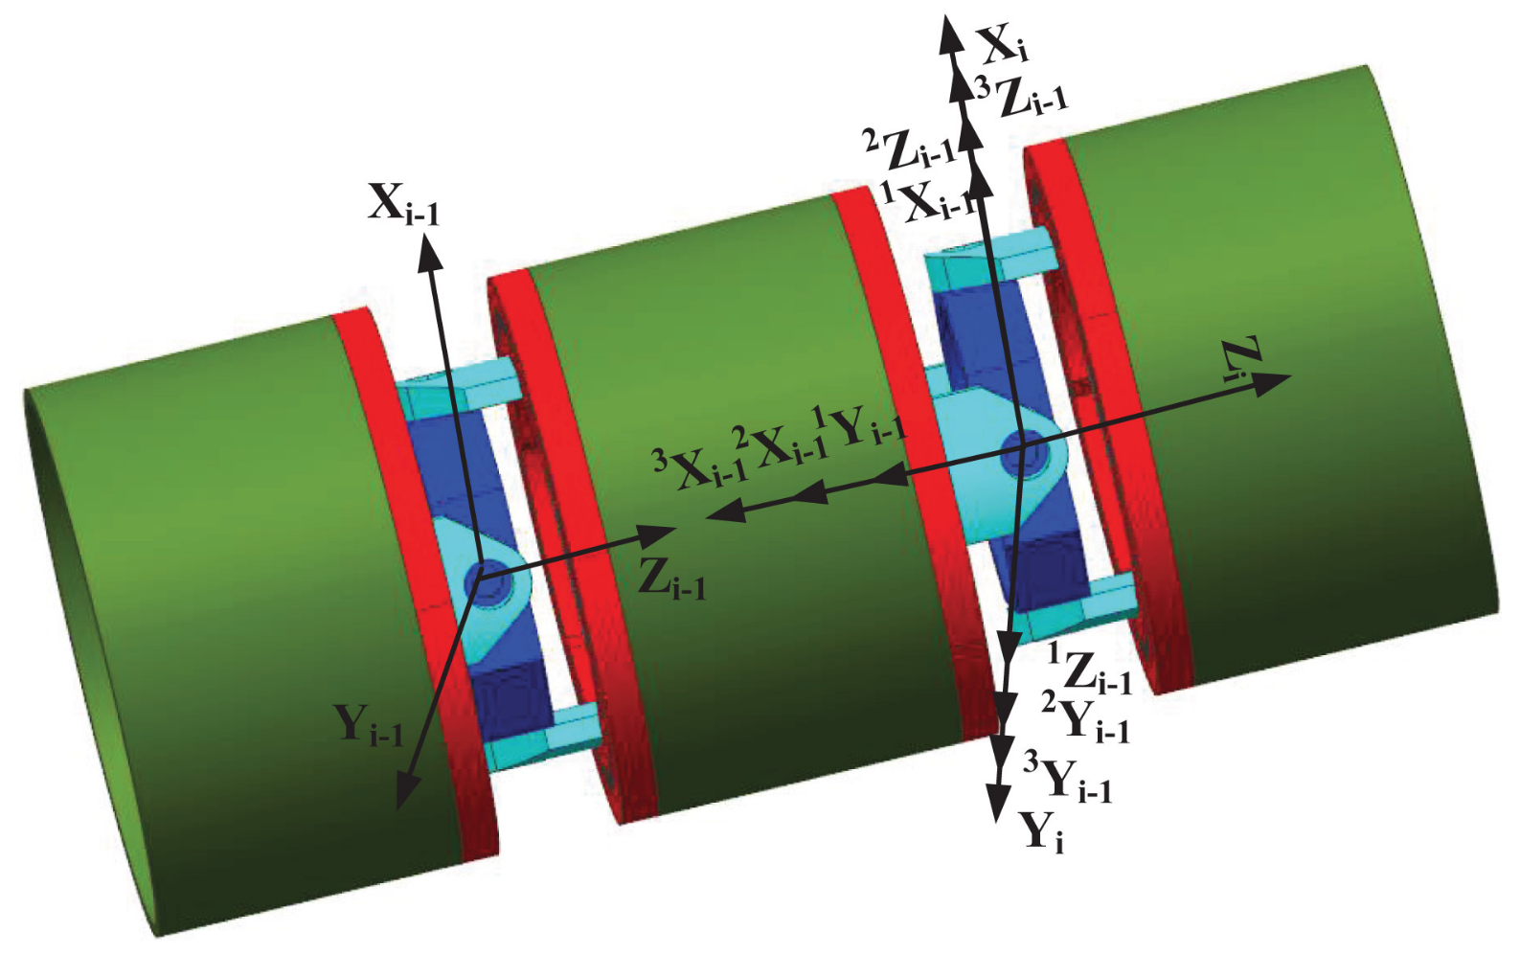
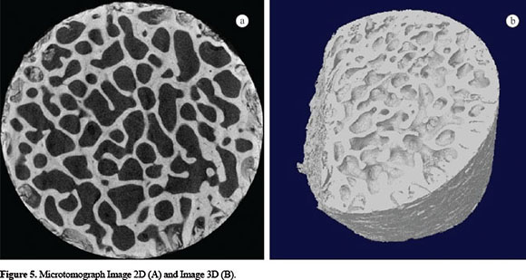
1. Background and Purpose
Demand for frictional-bearing contacting surface of kinetic joint
bionic robots & aerocrafts
Application subject for this reserach: snake-like robot
Porous structure of human joint
Physical properties: applicable
1. High strength-mass ratio
2. Self-lubrication → improve frictional resistance
Mathematical property:
Similarity among each pore → fractal property
Purpose 1: propose an engineering design fitting in the above physical properties
Purpose 2: propose a computer model biomimicing fractal property of micropore structure of human bone

Slide 3
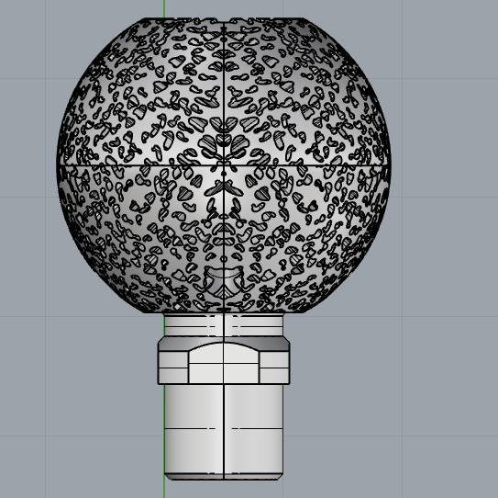
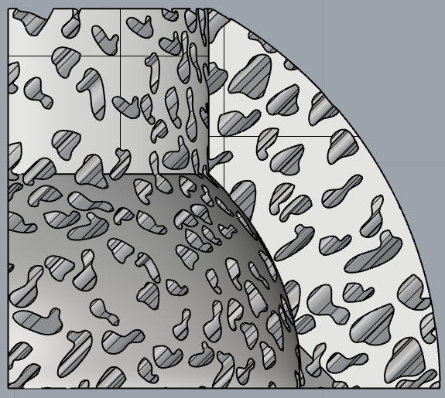
Porous structure of human joint
Mathematical property:
Similarity among each pore
Physical properties:
1. High strength-mass ratio
2. Self-lubrication

Slide 4
1. Background and Purpose
Demand for frictional-bearing contacting surface of kinetic joint
bionic robots & aerocrafts
Application subject for this reserach: snake-like robot
Porous structure of human joint
Physical properties: applicable
1. High strength-mass ratio
2. Self-lubrication → improve frictional resistance
Mathematical property:
Similarity among each pore → fractal property
Purpose 1: propose an engineering design fitting in the above physical properties
Purpose 2: propose a computer model biomimicing fractal property of micropore structure of human bone

Slide 5
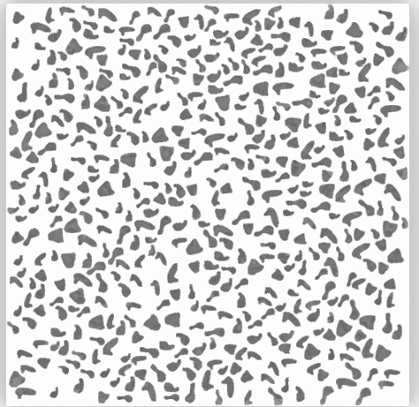
2. Material and Method
Fractal property of bone pore structure
Calculation of fractal dimension of individual micropore:
log P(ε) ＝ Dlog α(ε) + (D/2)log A(ε)
Four of the micropores, representing the overall micro-structure of human bones, are imitated
Generation of bionic pores of human bone
Generate closed B-spline with the same fractal dimension with porous structure of human bone
Import the generated closed B-spline to Acis.
Generation of 3D bionic porous structure
The cross-sectional pore distribution of the structure is similar to that of human bone
The porous structure has a controllable randomness in terms of shape and size
→ geometric similarity between micropores
four closed B-spline generated by MATLAB
image with porosity 30% and 70% generated by C++
internal design of porous spherical hinge for additive manufacture

Slide 6
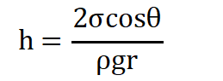
3. Results
Design of spherical hinge with biomimetic porous structure for snake-like robot
Methodology：
Set the wall thickness of spherical hinge and sizes of pores to reach self-lubricating biomimetic structure
According to the capillary phenomenon formula:
r: the radius of the tube; ρ: the liquid density;
θ: the intersection angle between the liquid level and the pipe wall
Independent variable: r tube radius.
Minimize areas of the pores until the minimum resolution of 3D printing is reached→ self-lubrication
Calculate the porosity of surface of spherical hinge to obtain the highest strength-mass ratio
Obtain the appropriate ratio of length (L) to diameter of the spherical hinge to reach the greatest rotational angle
L
self-similar fractal pores
spherical hinge with self-lubricating structure

Slide 7
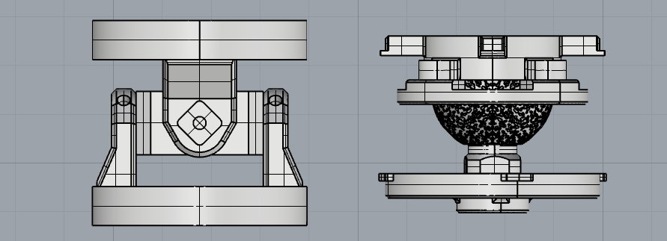
3. Results
Original Hooke joint:
ultimate rotational angle: 37 degrees
volume(single joint): 20.43±1.1e-05 m³
Without self-lubrication property
Spherical joint with bionic pores:
ultimate rotational angle: 42 degrees
volume(single joint): 11.79±4.3e-06 m³
With self-lubrication property
Original Hooke joint Spherical joint with bionic pores

Slide 8
4. Conclusion
The bionic spherical hinge joint is successfully applied on the snake-like robot
The bionic spherical hinge joint rotated freely to various directions
Reached a rotational angle of 42 degrees
Inventive points:
1. design of biomimetic porous structure applicable to kinetic pairs, which is realized by a mathematical model generating geometric models for fractal porous structure of human bone
2. porous design with enhanced physical properties applied to spherical hinge of snake-like robot, of which hinges reach self-lubrication property, high strength-mass ratio, and enlarged freedom

Slide 9
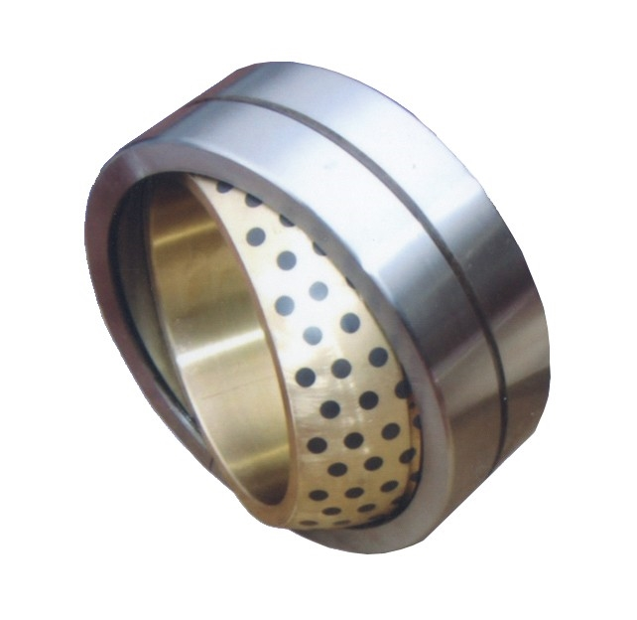
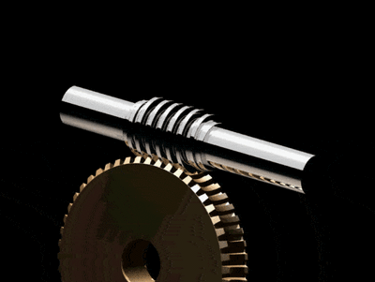
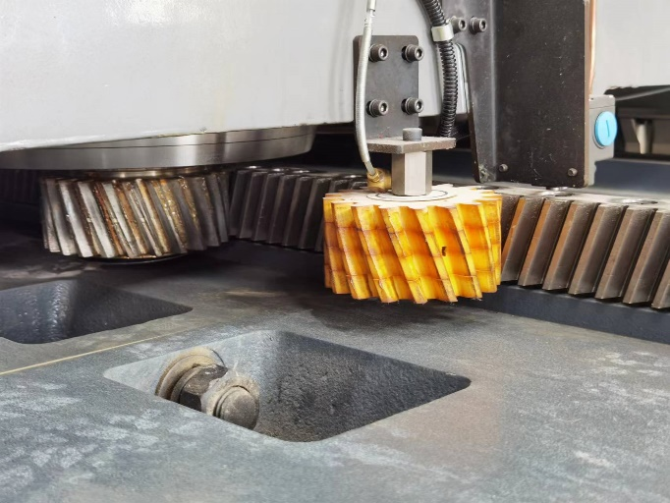
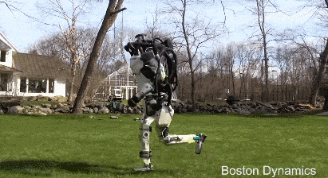
5. Appendix
Fields that biomimetic porous structure is applicable to：
bearing
frictional transmission
lubricating system
LOW MASS
LOW MAINTENANCE COST

Slide 10
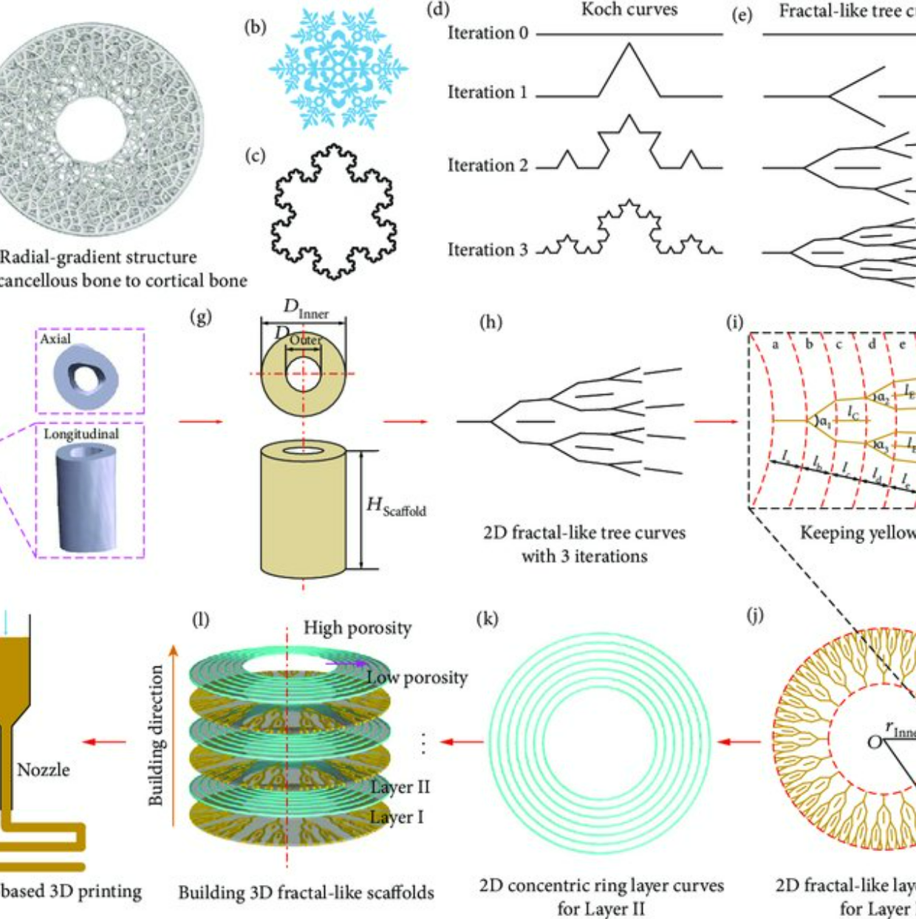
4. Discussion and conclusion
Nowaday’s research on bionic structure of human bone.
1. There is a lack of a simple bone microstructure modeling method, and it is difficult for commercial CAD software to realize the modeling of fractal graphics.
2. There are few studies on the physical properties of bone microstructures and applications in mechanical products
In Fractal Design Boosts Extrusion-Based 3D Printing of Bone-Mimicking, the authors propose a biomimetic scheme for the fractal structure of bones.

